Slide 1

Navigating Tomorrow's Talent Landscape
In today's dynamic job market, understanding evolving trends is crucial. This project leverages cutting-edge data analytics to provide actionable insights, empowering product managers, talent acquisition leaders, and workforce analysts to make informed decisions.

Slide 2
Project Overview
Data-Driven Workforce Intelligence
Dynamic Market Analysis
Actionable Insights
Predictive Capabilities
Providing clear, data-backed recommendations for job seekers and recruiters.
Harnessing data to understand the interplay of technology, economic shifts, and cultural trends in the job market.
Forecasting high-demand roles and future trends to enable proactive strategy.

Slide 3
Core Analytics Tasks
Unlocking Key Job Market Insights
01
02
03
Salary-Keyword Correlation
Emerging Job Categories
High-Demand Role Prediction
Identifying new and growing job categories through frequency and trend analysis of job postings.
Analyzing the relationship between job title keywords and offered salaries to uncover compensation patterns.
Forecasting future high-demand job roles using historical posting patterns and predictive modeling.

Slide 4
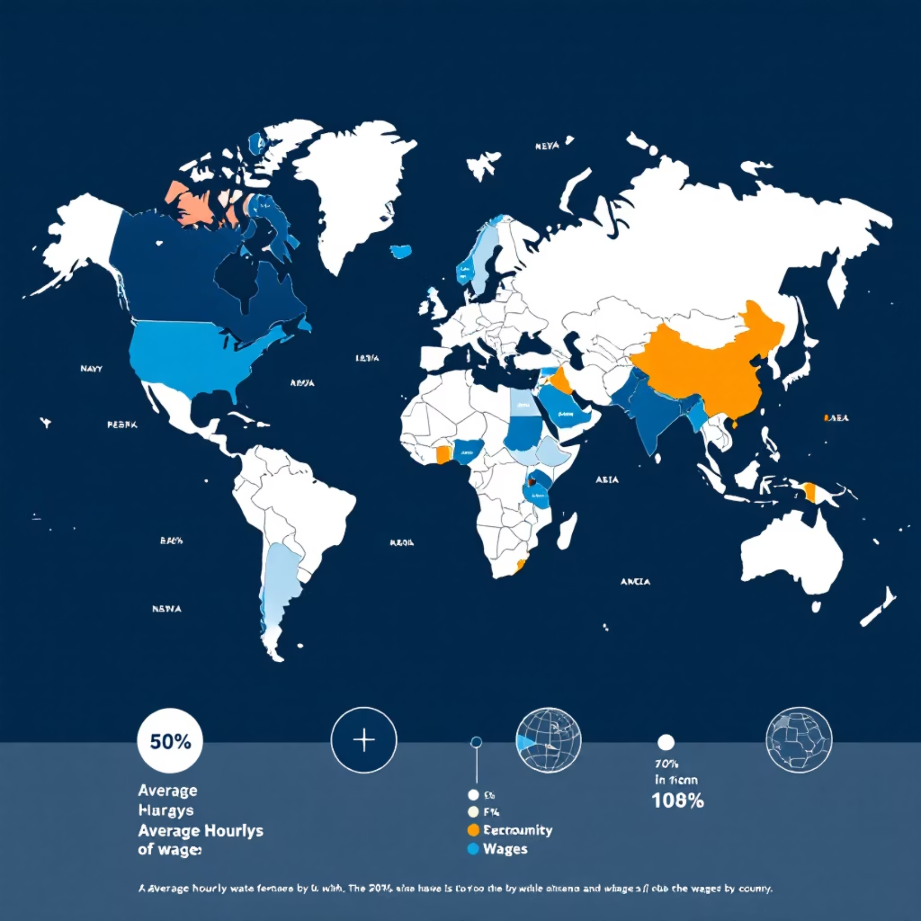

Global & Personalized Insights
Mapping Rates and Recommending Roles
Global Hourly Rate Comparison
Personalized Job Recommendations
Comparing average hourly rates across different countries to highlight geographical compensation differences. This will be visualized on an interactive map.
Developing a robust job recommendation engine to provide tailored suggestions based on individual profiles and real-time job postings.

Slide 5
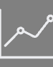

Continuous Monitoring
Tracking Market Dynamics Monthly
Monthly Updates
Trend Spotting
Proactive Adjustments
A dedicated dashboard providing real-time updates on key job market trends.
Visualizing shifts in demand, supply, and emerging skills to keep you informed.
Enabling agile responses to market changes for recruiters and talent acquisition.

Slide 6


Future Workforce Trends
Analyzing Remote Work and Future Scenarios
Remote Work Landscape
Predicting Future Trends
Investigating the growth and impact of remote work, providing data-backed forecasts on its future trajectory. We will analyze the prevalence, industry adoption, and long-term implications for workforce planning.
Utilizing advanced predictive analytics to foresee broader job market shifts, offering insights into potential future scenarios and their impact on talent strategies. This will involve macroeconomic indicators and technological forecasts.

Slide 7




Technology Stack
Powerful Tools for Data Science
Python & SQL
Pandas & Scikit-Learn
Core languages for data processing and database interaction.
Libraries for data manipulation and machine learning models.
TensorFlow
Matplotlib & Plotly
Framework for deep learning applications and complex predictive models.
Tools for static and interactive data visualizations.

Slide 8



Web Development & Deployment
Building a Robust and Scalable Platform
Web Frameworks
Docker Containerization
Docker Compose
Utilizing Flask or Django for efficient API development and backend logic.
Managing multi-container setups for complex services and streamlined orchestration.
Packaging applications with dependencies for consistent environments and seamless deployment.

Slide 9
Key Deliverables
Tangible Outcomes of the Project
Correlation Reports: In-depth statistical analyses and visualizations of job title keywords and salaries.
Emerging Category Lists: Identified new job categories with growth analysis over time.
Predictive Models: Forecasts for high-demand roles with accuracy metrics and trend visualizations.
Interactive Dashboards: Monthly updated insights into job market dynamics and trends.
Recommendation Engine Prototype: A functional prototype with API documentation and a user-friendly UI.
Remote Work Trend Reports: Comprehensive analyses and forecasts on the remote work landscape.
Docker Infrastructure: Dockerfiles, Docker Compose scripts, and deployment instructions for all services.

Slide 10

Empowering Your Workforce Strategy
This project offers a comprehensive, data-driven approach to understanding and navigating the complexities of the job market. By integrating advanced analytics with a user-friendly recommendation system, we aim to provide unparalleled insights for talent acquisition, product development, and strategic workforce planning.
Leverage these insights to stay ahead in the competitive talent landscape.

